Slide 1
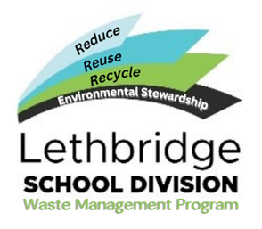
Sustainable Schools
Best Practices Guide

Slide 2
Why have a waste management program?
Beyond complying with municipal regulations, recycling is simply the right thing to do for our environment. Schools generate a lot of waste, from paper and other classroom materials used daily, to food and snacks in classrooms, cafeterias, and canteens.
Learning about the impacts of recycling on our environment promotes ethical citizenship and the belief that the smallest actions matter. We can make a difference to our environment. By creating awareness and changing our waste management practices, we have an opportunity to have a positive impact on our future.

Slide 3
Who is responsible for the waste management program?
All staff and students at Lethbridge School Division have a valuable role to play in reducing waste by participating in the Lethbridge School Division Waste Program.
School administrators, teachers, support staff, caretakers, and students working together will make waste management easier and effective.
The goal of the program will be to develop a culture of responsible waste management in our school communities.

Slide 4
How do we build a culture of waste management?
“Hope is a verb with its sleeves rolled up” Dr. David Orr
An efficient and effective waste management program requires that all students and staff are involved. The Division will support infrastructure and division wide communication strategies. Schools will be responsible for tailoring the day-to day practices to their school community.

Slide 5
What wastes need to be managed?
The City of Lethbridge dictates the type of materials that may be considered waste, recyclable, or organics. Lethbridge School Divisions will follow these guidelines with a few exceptions. A bin system will be used to assist with the sorting of materials.
Recyclables: Blue bin – paper, cardboard, hard plastics, metal cans, newspaper, etc.
Organics: Green bin – “table scraps”, plants, leaves, food soiled paper products, shredded paper, etc.
Refundable: Grey bin – juice boxes, pop cans, milk containers, etc.
Waste: Black bin – plastic bags, Styrofoam, mixed product packaging and items that don’t fit the other categories.

Slide 6
Recycling (blue bin)

Slide 7
Organics (green bin)

Slide 8
Refundables (grey bin)

Slide 9
Landfill (black bin)

Slide 10
Locations of bins
Each classroom will have a recycling bin and a landfill bin
Organics & Refundable bins will be in each grade level hallway and the foyer. Please access these and use appropriate bins!
The Foods room and other strategic locations in the school will have organics bins as well

Slide 11
Effort & consideration
Please be show some effort and consideration by seeking out and using appropriate bins. Caretakers go through refundable bins each week and it’s a nasty job when incorrect bins aren’t used!

